Slide 1
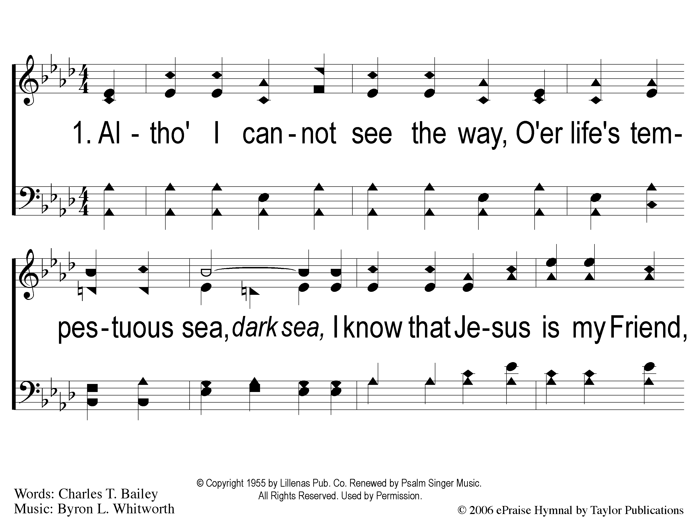
1-1 He Will Pilot Me
He Will Pilot Me
164

Slide 2
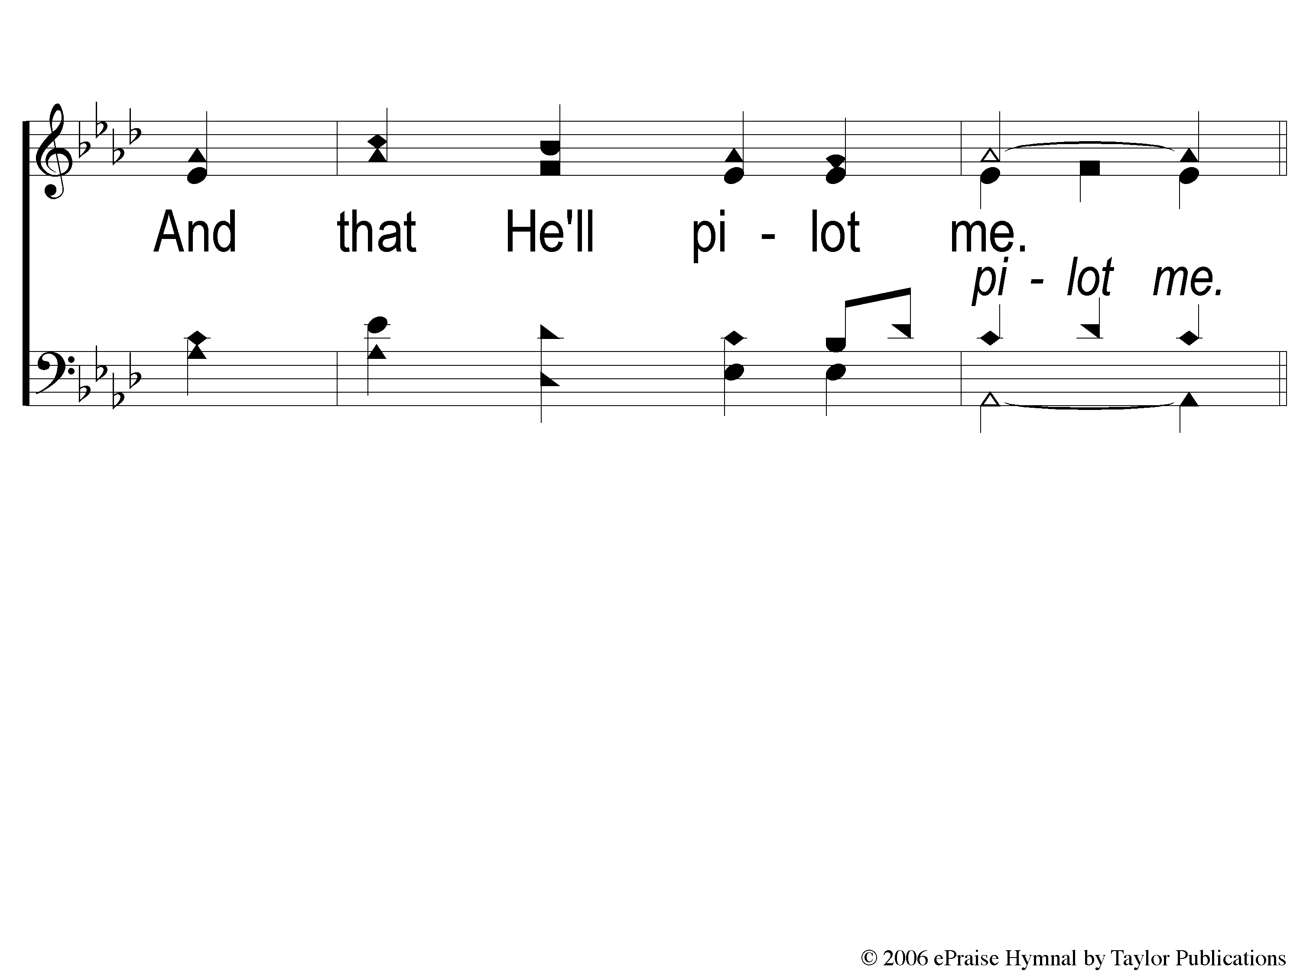
1-2 He Will Pilot Me
He Will Pilot Me
164

Slide 3
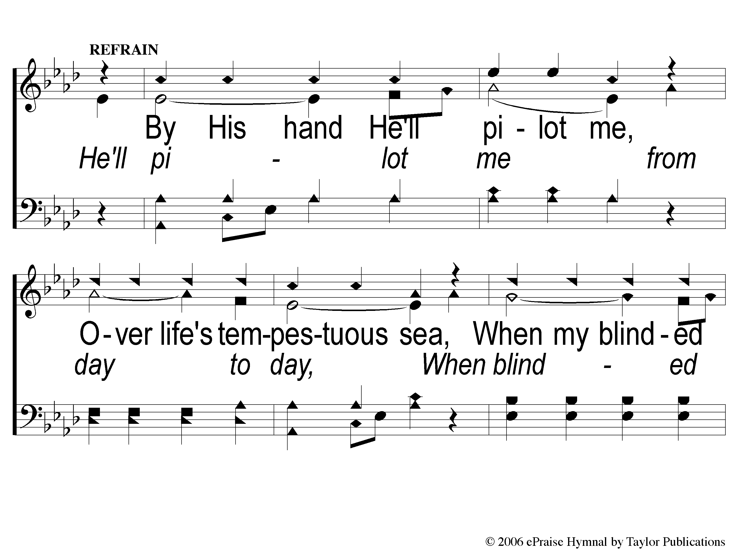
C-1 He Will Pilot Me
He Will Pilot Me
164

Slide 4
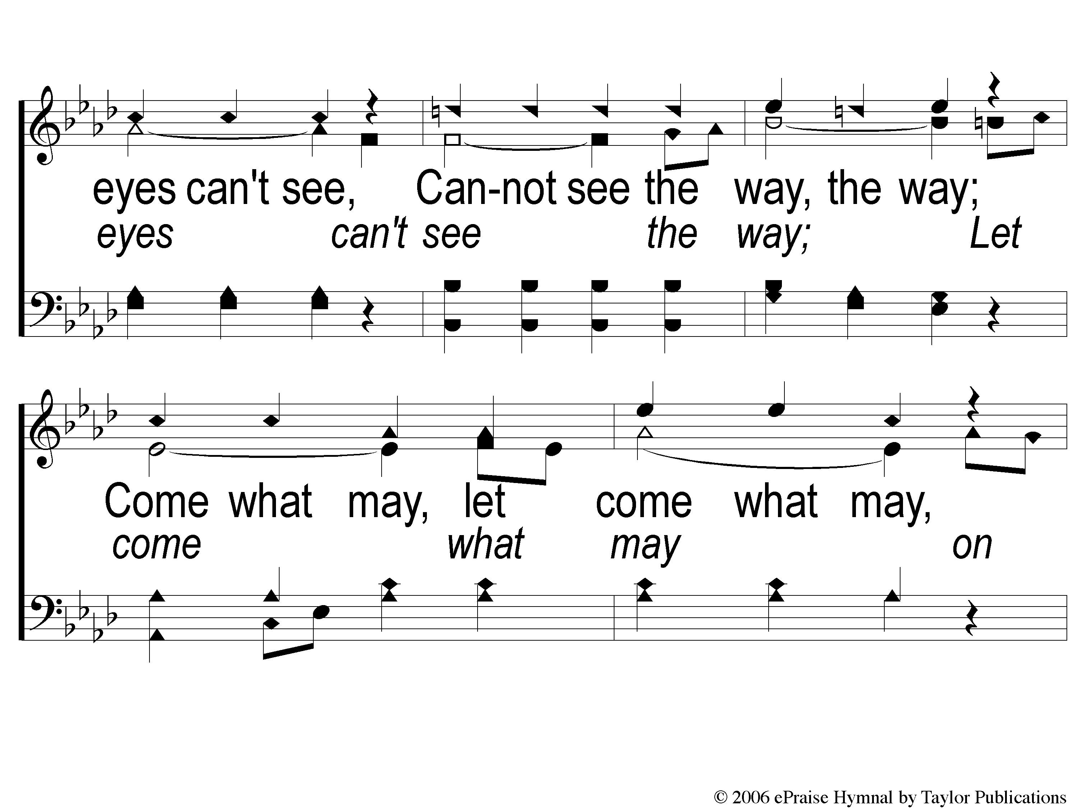
C-2 He Will Pilot Me
He Will Pilot Me
164

Slide 5
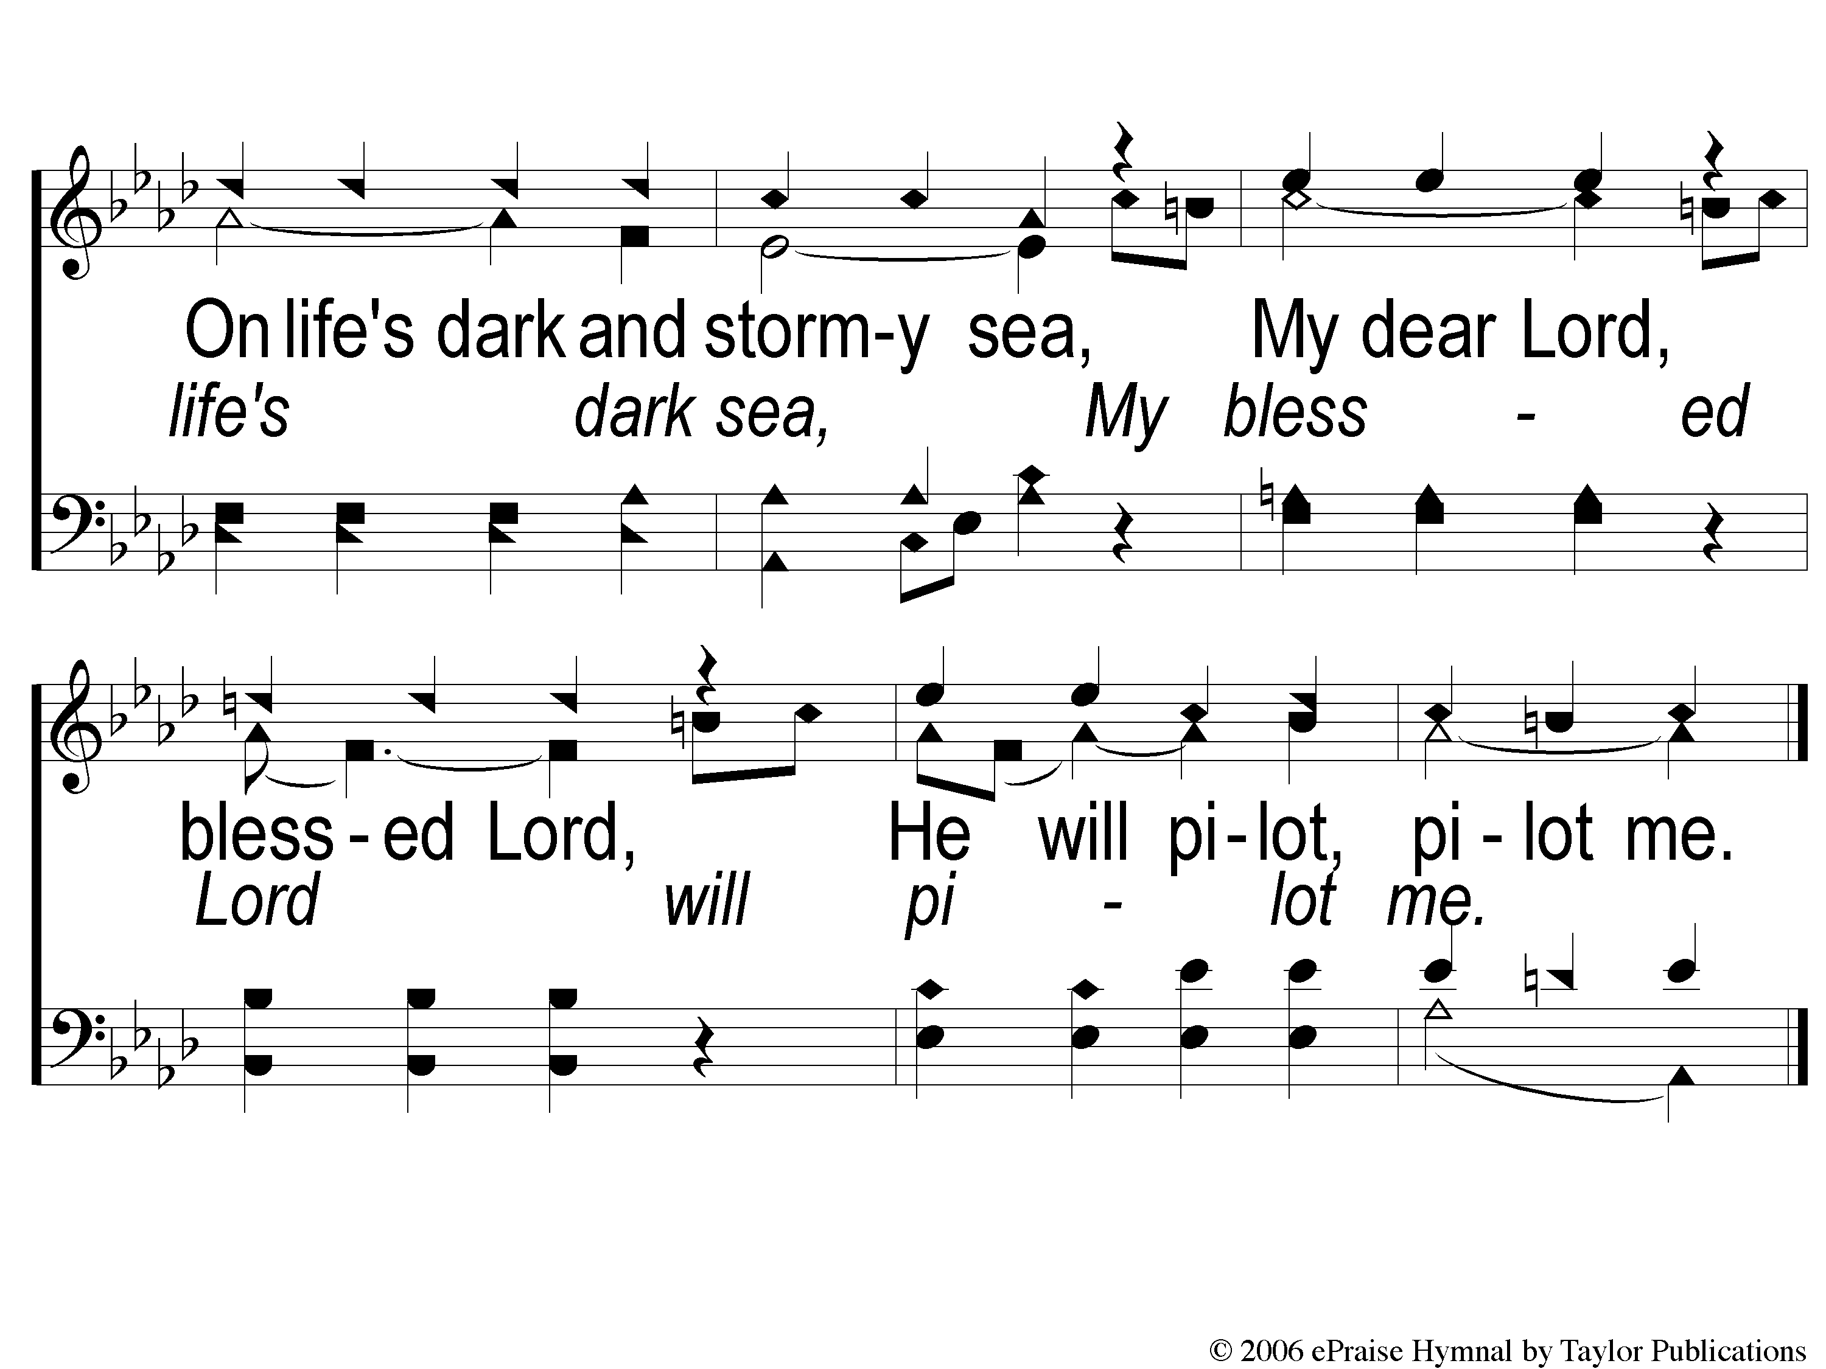
C-3 He Will Pilot Me
He Will Pilot Me
164

Slide 6
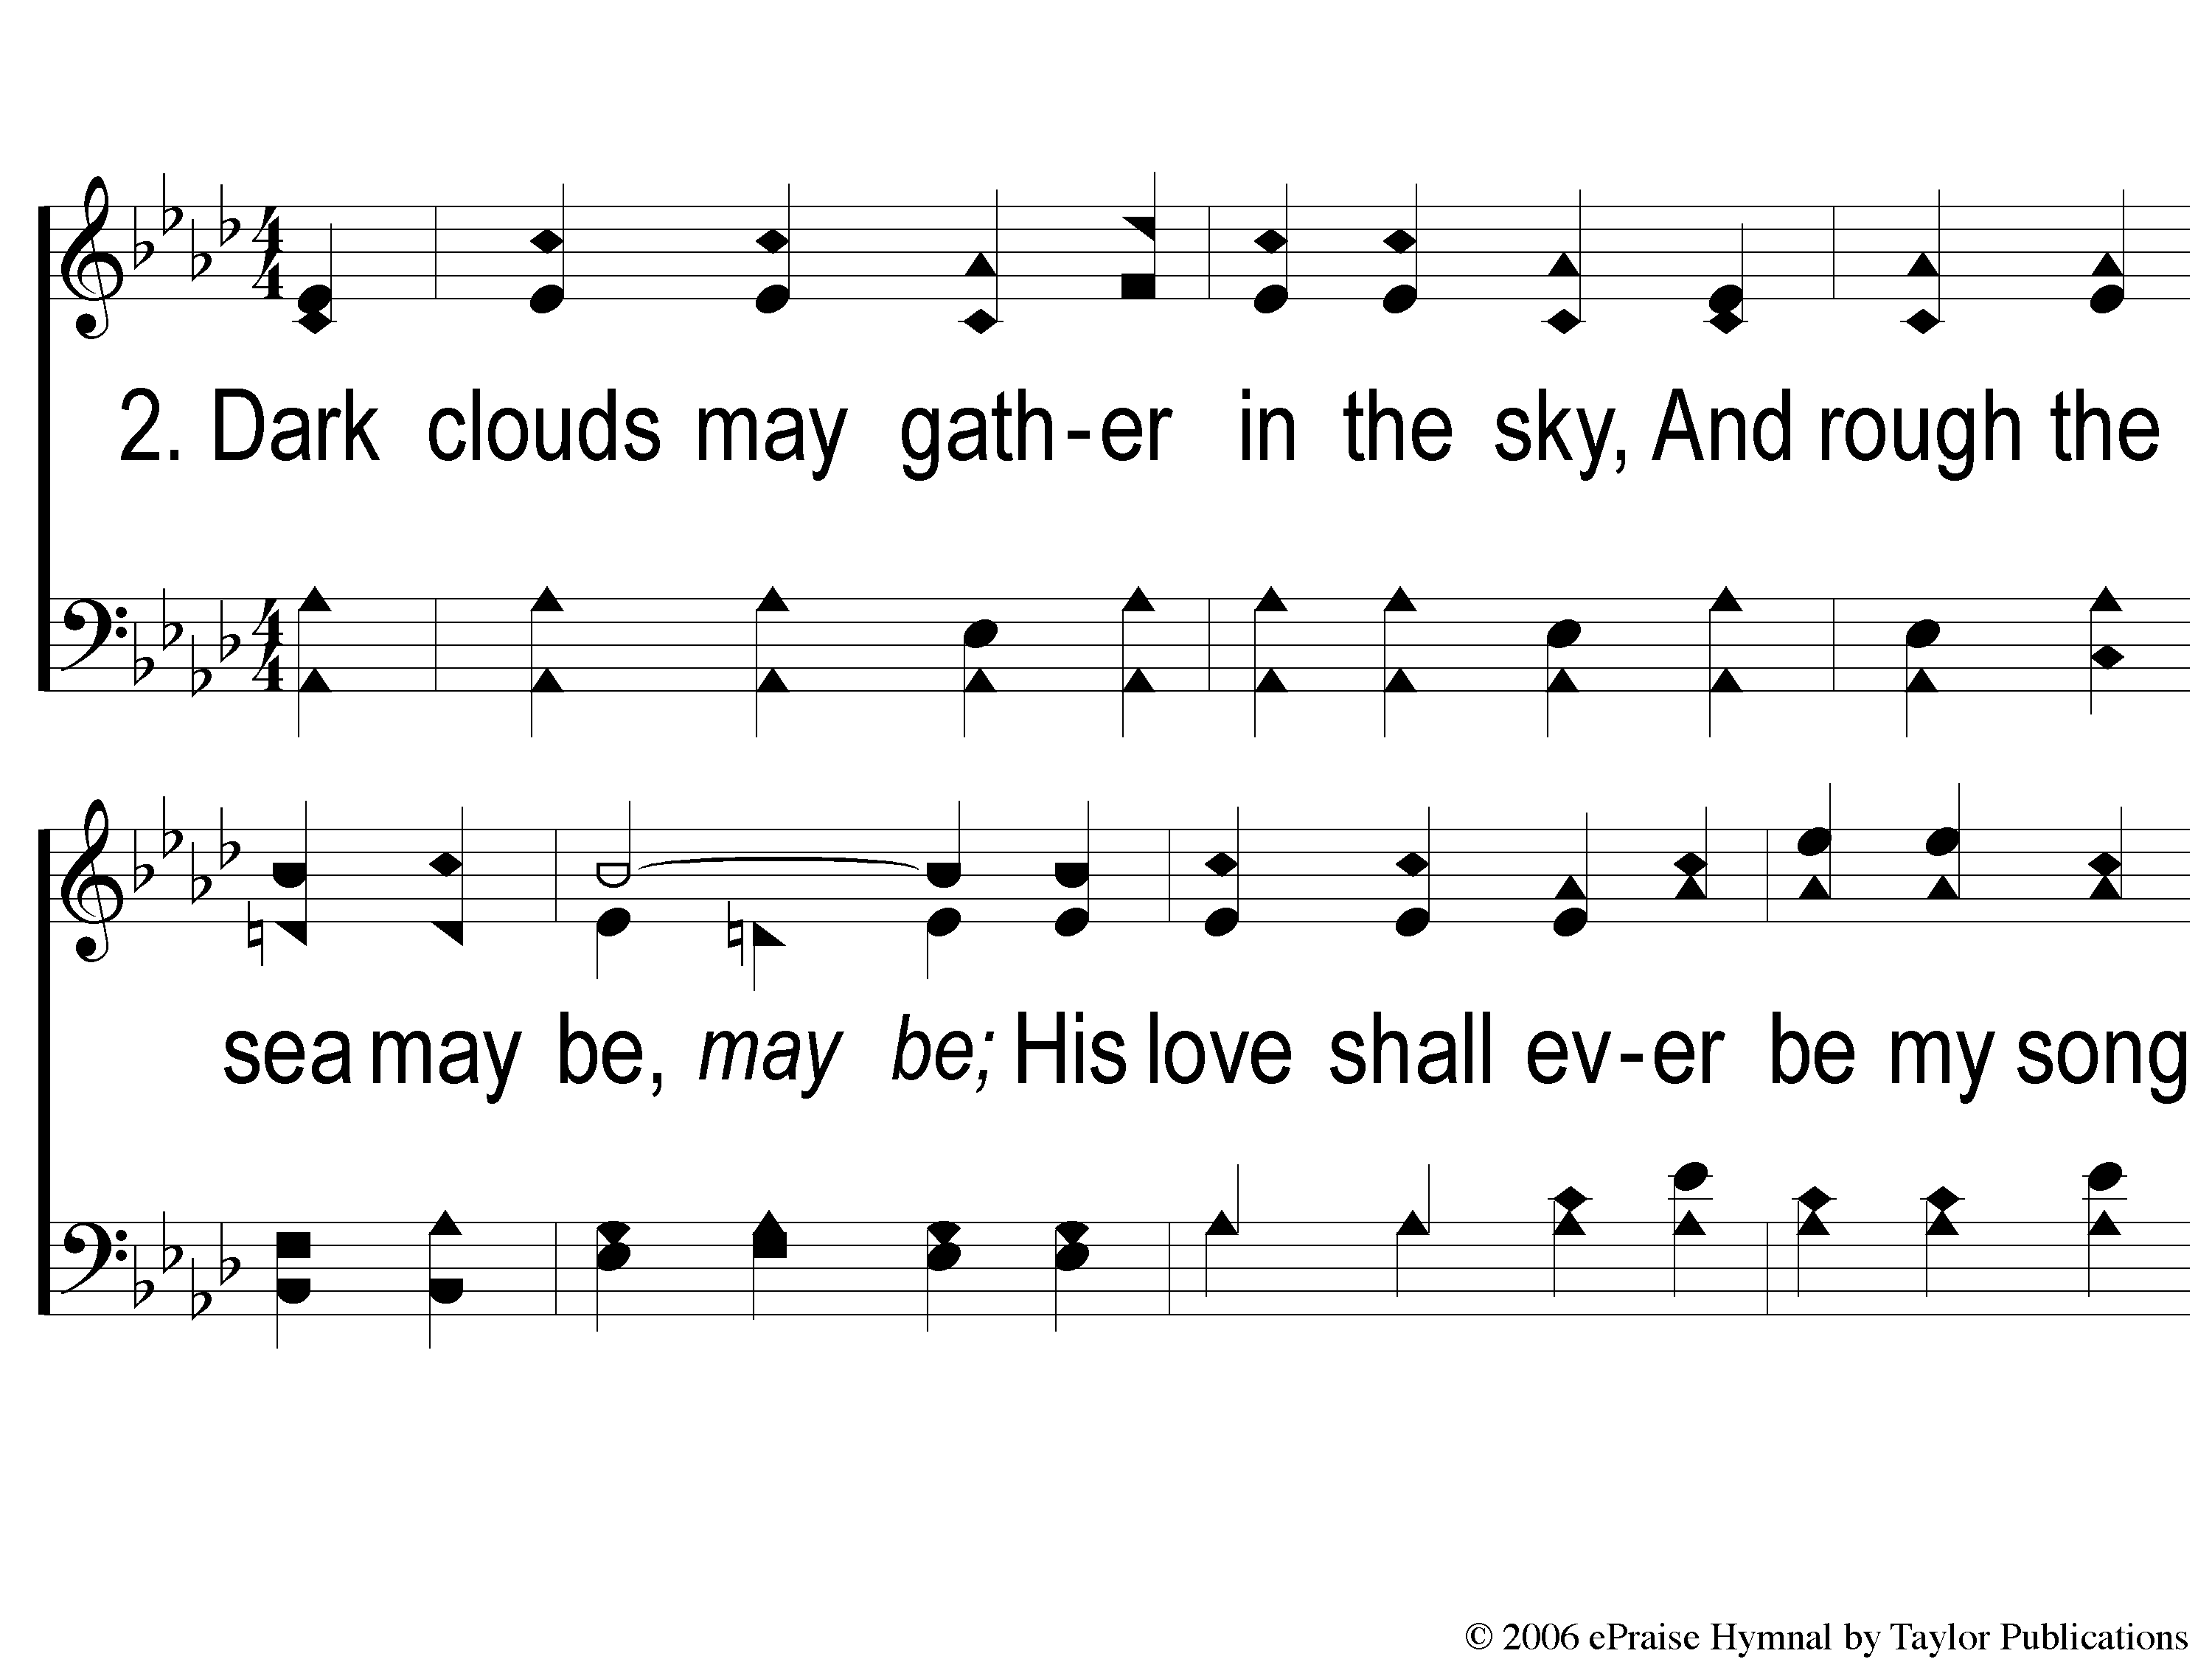
2-1 He Will Pilot Me
He Will Pilot Me
164

Slide 7
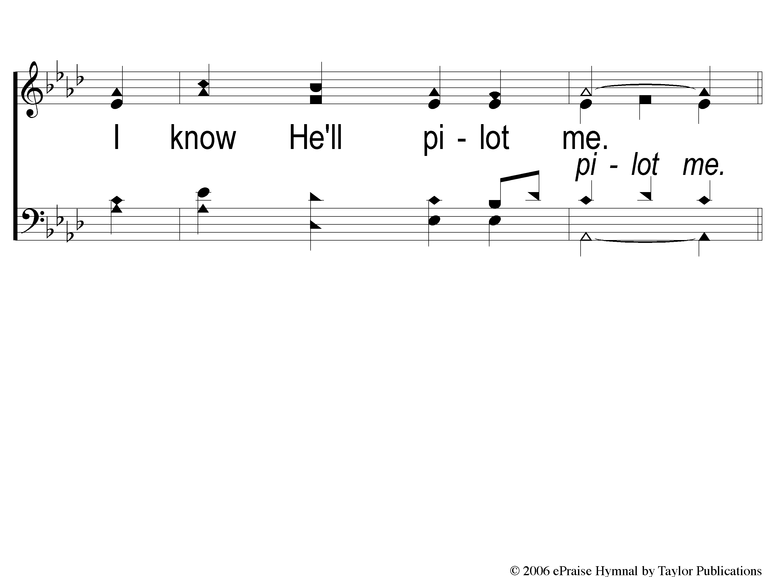
2-2 He Will Pilot Me
He Will Pilot Me
164

Slide 8
C-1 He Will Pilot Me
He Will Pilot Me
164

Slide 9
C-2 He Will Pilot Me
He Will Pilot Me
164

Slide 10
C-3 He Will Pilot Me
He Will Pilot Me
164

Slide 11
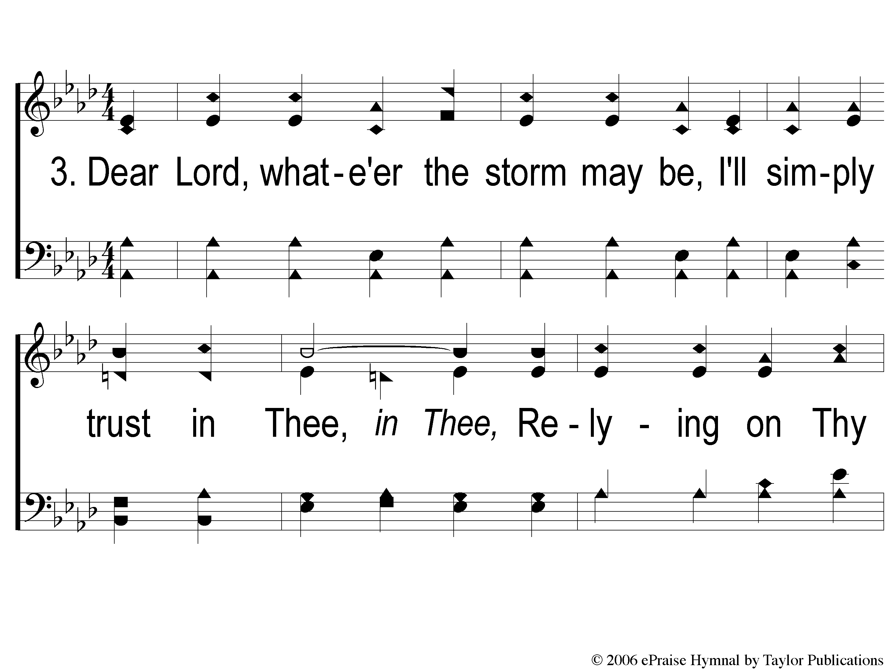
3-1 He Will Pilot Me
He Will Pilot Me
164

Slide 12
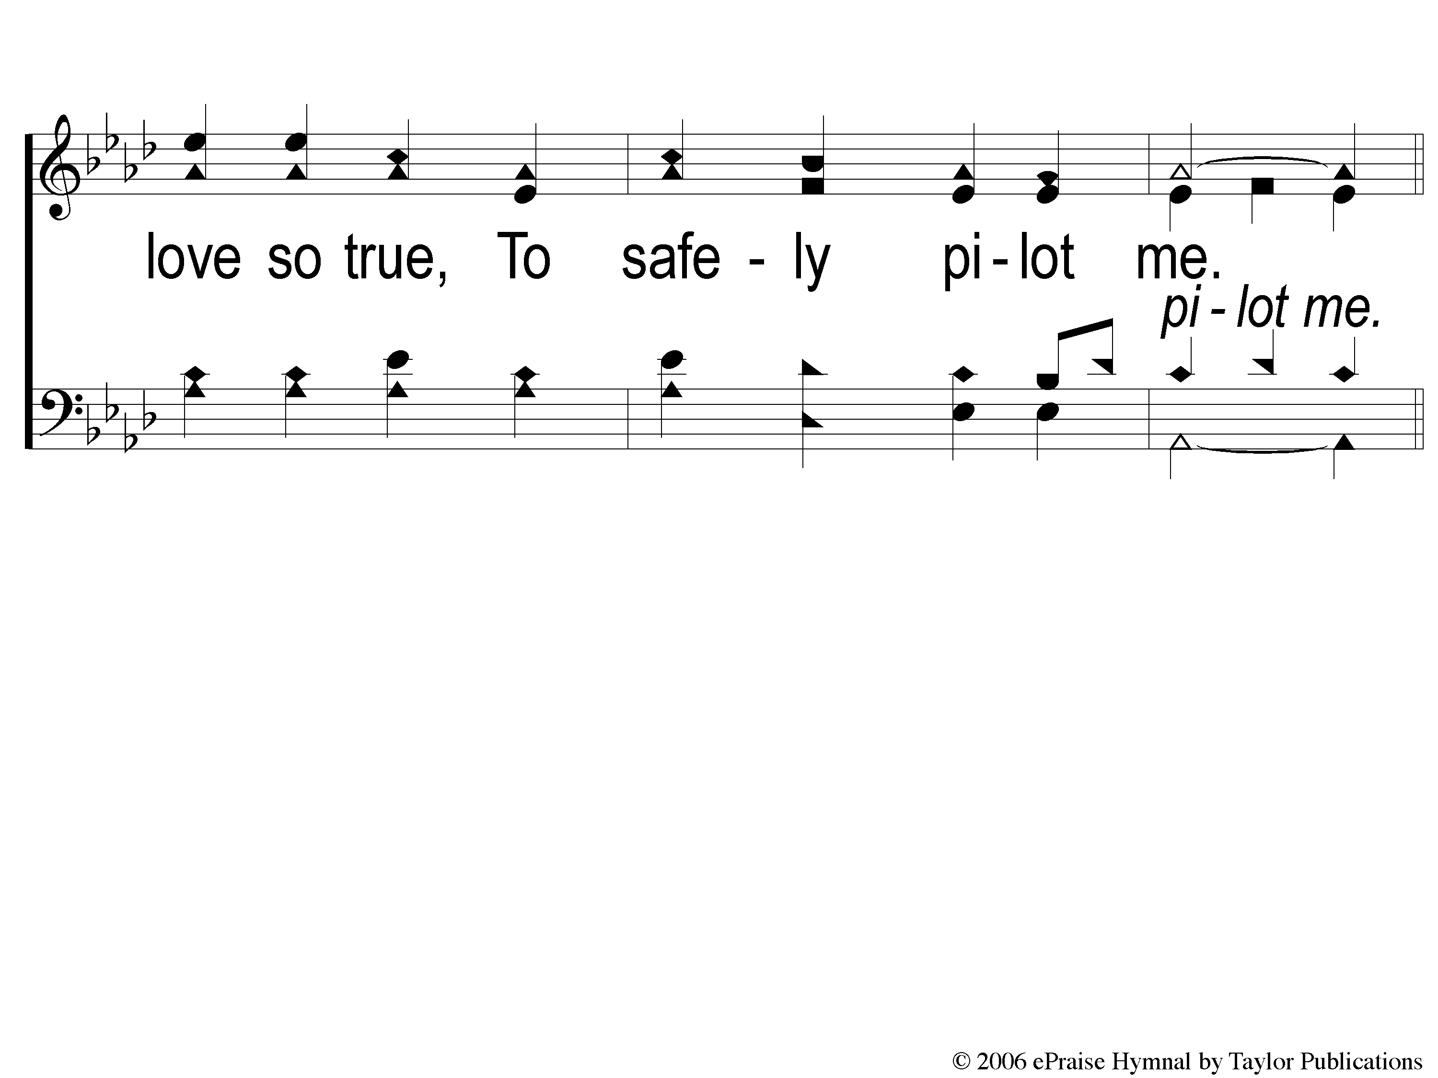
3-2 He Will Pilot Me
He Will Pilot Me
164

Slide 13
C-1 He Will Pilot Me
He Will Pilot Me
164

Slide 14
C-2 He Will Pilot Me
He Will Pilot Me
164

Slide 15
C-3 He Will Pilot Me
He Will Pilot Me
164

